Slide 1
HEAPS
Dr.Priyanka N

Slide 2
GOALS
To explore the implementation, testing and performance of heap sort algorithm

Slide 3
HEAP
A heap is a data structure that stores a collection of objects (with keys), and has the following properties:
  Complete Binary tree
  Heap Order
It is implemented as an array where each node in the tree corresponds to an element of the array.
An array is viewed as a nearly complete binary tree
  Physically – linear array.
  Logically – binary tree, filled on all levels (except lowest.)

Slide 4
HEAPS
Root
A heap is a certain kind of complete binary tree.
When a complete
binary tree is built,
its first node must be
the root.
Notes:
The first node of a complete binary tree is always the root...

Slide 5
HEAPS
Complete binary tree.
Left child
of the
root
The second node is
always the left child
of the root.
Notes:
...the second node is always the left child of the root...

Slide 6
HEAPS
Complete binary tree.
Right child
of the
root
The third node is
always the right child
of the root.
Notes:
...then the right child of the root...

Slide 7
HEAPS
Complete binary tree.
The next nodes
always fill the next
level from left-to-right.
Notes:
...and so on. The nodes always fill each level from left-to-right...

Slide 8
HEAPS
Complete binary tree.
The next nodes
always fill the next
level from left-to-right.
Notes:
...from left-to-right...

Slide 9
HEAPS
Complete binary tree.
The next nodes
always fill the next
level from left-to-right.
Notes:
...from left-to-right...

Slide 10
HEAPS
Complete binary tree.
The next nodes
always fill the next
level from left-to-right.
Notes:
...from left-to-right...

Slide 11
HEAPS
Complete binary tree.
Notes:
...and when a level is filled you start the next level at the left.

Slide 12
HEAPS
45
A heap is a certain kind of complete binary tree.
35
23
27
21
22
4
19
Each node in a heap
contains a key that
can be compared to
other nodes' keys.
Notes:
So, a heap is a complete binary tree. Each node in a heap contains a key, and these keys must be organized in a particular manner. Notice that this is not a binary search tree, but the keys do follow some semblance of order.
Can you see what rule is being enforced here?

Slide 13
HEAPS
45
A heap is a certain kind of complete binary tree.
35
23
27
21
22
4
19
The "heap property"
requires that each
node's key is >= the
keys of its children
Notes:
The heap property requires that each node's key is >= to the keys of its children.
This is a handy property because the biggest node is always at the top. Because of this, a heap can easily implement a priority queue (where we need quick access to the highest priority item).

Slide 14
HEAP- DEFINITION
The binary heap data structure is an array that can be viewed as a complete binary tree. Each node of the binary tree corresponds to an element of the array.
The array is completely filled on all levels except possibly lowest.
19
12
16
1
4
7

Slide 15
IMPLEMENTING A HEAP
42
We will store the data from the nodes in a partially-filled array.
35
23
27
21
An array of data

Slide 16
IMPLEMENTING A HEAP
Data from the root goes in the first location of the array.
42
35
23
27
21
42
An array of data
Notes:
Following the usual technique for implementing a complete binary tree, the data from the root is stored in the first entry of the array.

Slide 17
IMPLEMENTING A HEAP
42
Data from the next row goes in the next two array locations.
35
23
27
21
42
35
23
An array of data
Notes:
The next two nodes go in the next two locations of the array.

Slide 18
IMPLEMENTING A HEAP
42
Data from the next row goes in the next two array locations.
35
23
27
21
42
35
23
27
21
An array of data
Notes:
and so on.

Slide 19
IMPLEMENTING A HEAP
42
Data from the next row goes in the next two array locations.
35
23
27
21
42
35
23
27
21
An array of data
We don't care what's in
this part of the array.
Notes:
As with any partially-filled array, we are only concerned with the front part of the array. If the tree has five nodes, then we are only concerned with the entries in the first five components of the array.

Slide 20
IMPORTANT POINTS ABOUT THE IMPLEMENTATION
The links between the tree's nodes are not actually stored as pointers, or in any other way.
The only way we "know" that "the array is a tree" is from the way we manipulate the data.
42
35
23
27
21
42
35
23
27
21
An array of data
Notes:
With this implementation of a heap, there are no pointers. The only way that we know that the array is a heap is the manner in which we manipulate it.

Slide 21
IMPORTANT POINTS ABOUT THE IMPLEMENTATION
42
If you know the index of a node, then it is easy to figure out the indexes of that node's parent and children.
35
23
27
21
42
35
23
27
21
[1] [2] [3] [4] [5]

Slide 22
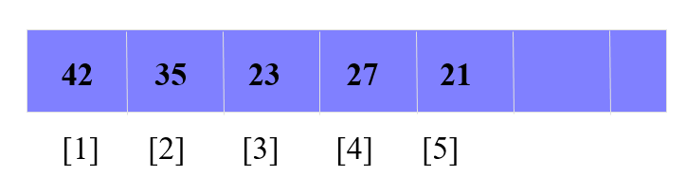
HEAP
The root of the tree A[1] and given index i of a node, the indices of its parent, left child and right child can be computed
PARENT (i)
return floor(i/2)
LEFT (i)
return 2i
RIGHT (i)
return 2i + 1
1
42
2
35
3
23
4
27
21
5

Slide 23
HEAP ORDER PROPERTY
For every node v, other than the root, the key stored in v is greater or equal (smaller or equal for max heap) than the key stored in the parent of v.
In this case the maximum value is stored in the root

Slide 24
MAX HEAP EXAMPLE
  Store data in ascending order
  Has property of
  A[Parent(i)] ≥ A[i]
19
12
16
1
4
7

Slide 25
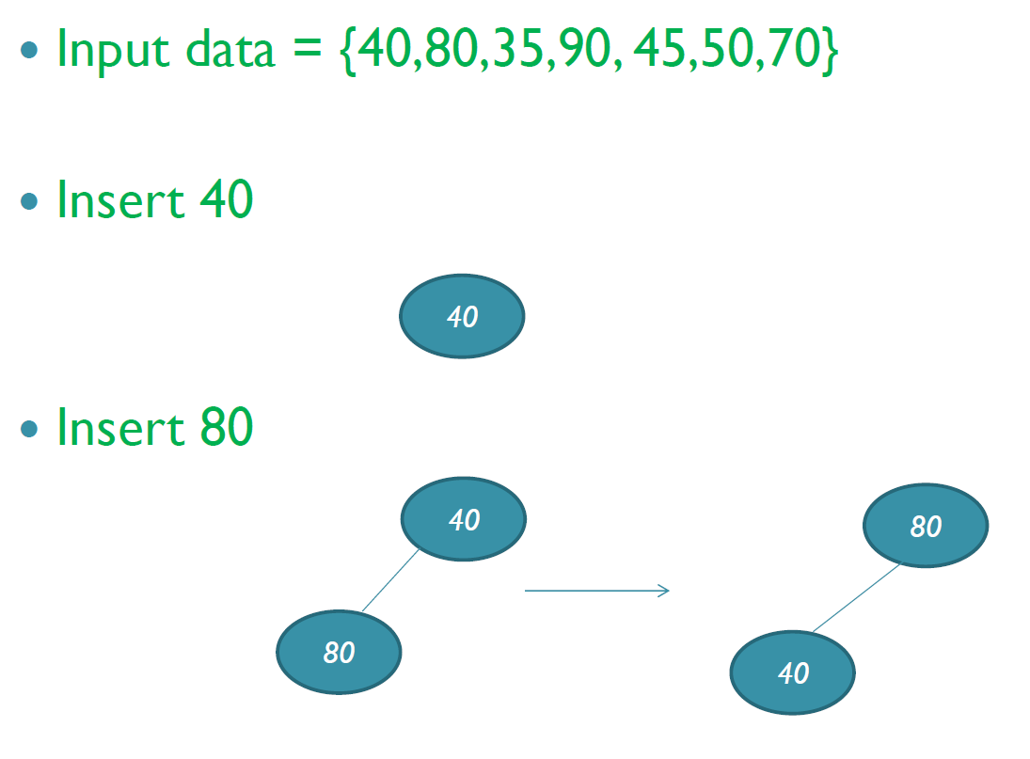
CONSTRUCTION OF MAX HEAP - EXAMPLE

Slide 26
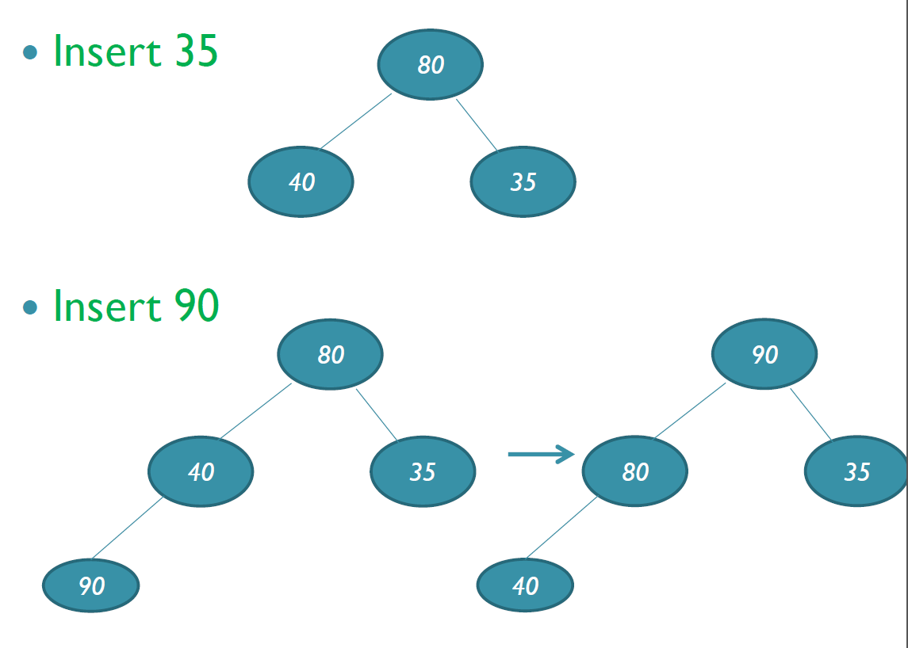
CONSTRUCTION OF MAX HEAP - EXAMPLE

Slide 27
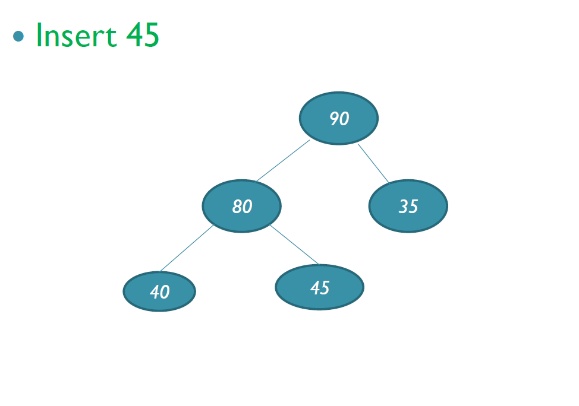
CONSTRUCTION OF MAX HEAP - EXAMPLE

Slide 28
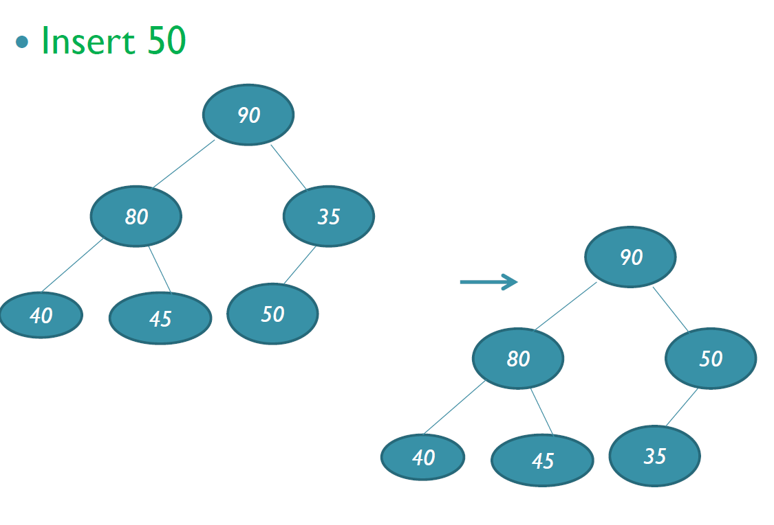
CONSTRUCTION OF MAX HEAP - EXAMPLE

Slide 29
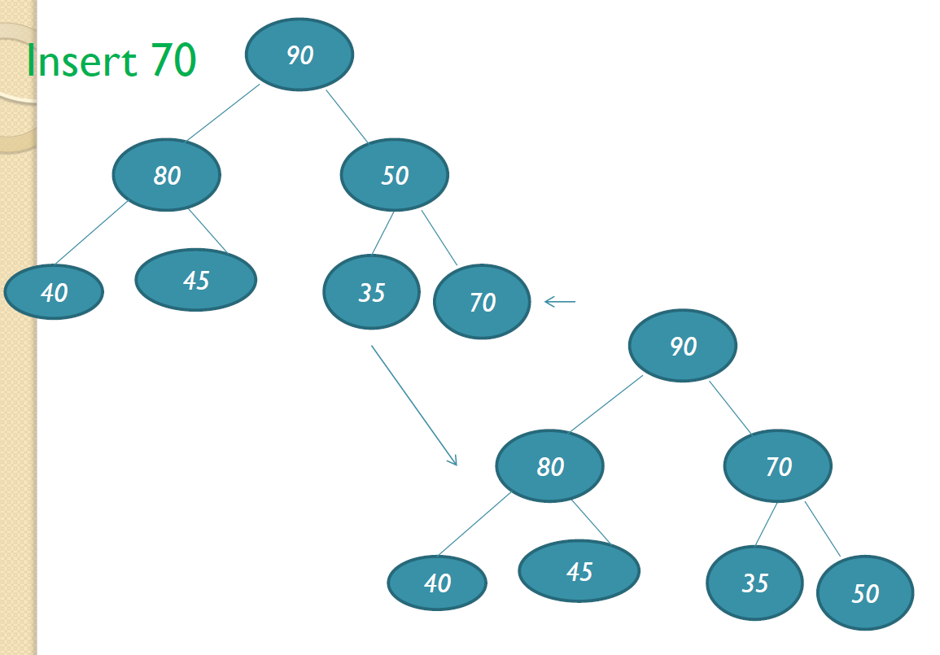
CONSTRUCTION OF MAX HEAP - EXAMPLE

Slide 30
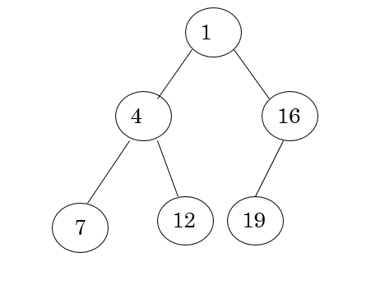
DEFINITION
Min Heap
  Store data in descending order
  Has property of
  A[Parent(i)] ≤ A[i]

Slide 31
INSERTION
Algorithm
  Add the new element to the next available position at the lowest level
  Restore the max-heap property if violated
    General strategy is percolate up (or bubble up): if the parent of the element is smaller than the element, then interchange the parent and child.
    OR
  Restore the min-heap property if violated
    General strategy is percolate up (or bubble up): if the parent of the element is larger than the element, then interchange the parent and child.

Slide 32
19
19
12
16
12
16
4
7
1
4
7
17
1
1
Insert 17
19
2
3
12
17
swap
4
5
6
7
1
4
7
16
Percolate up to maintain the heap property

Slide 33
19
1
19
2
3
12
16
12
16
4
5
6
7
4
7
1
4
7
17
1
Insert 17
PARENT (i)
return floor(i/2)
19 | 12 | 16 | 1 | 4 | 7 | 17
1 | 2 | 3 | 4 | 5 | 6 | 7

Slide 34
19 | 12 | 17 | 1 | 4 | 7 | 16
1 | 2 | 3 | 4 | 5 | 6 | 7
1
19
2
3
12
17
swap
4
5
6
7
1
4
7
16
Percolate up to maintain the heap property

Slide 35
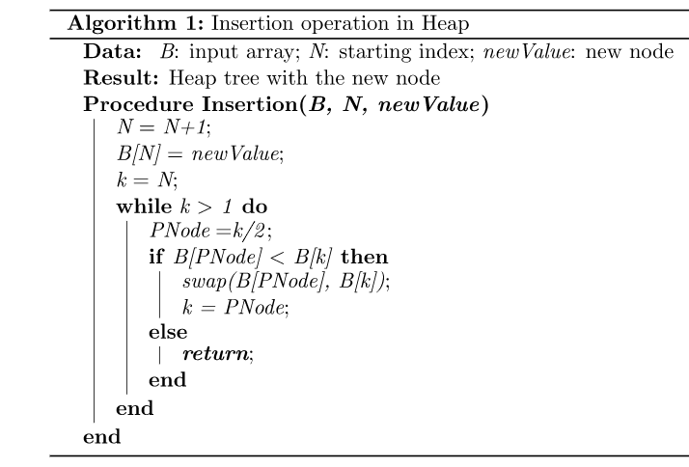
// Array B, heap size N,new node newValue
// Create a space in a heap to add the new node
//PNode to denote the parent node
N
N+1
B
19 | 12 | 16 | 1 | 4 | 7 | 17
1 | 2 | 3 | 4 | 5 | 6 | 7
PNode
k

Slide 36
DELETION
Delete max
  Copy the last number to the root ( overwrite the maximum element stored there ).
  Restore the max heap property by percolate down.
Delete min
  Copy the last number to the root ( overwrite the minimum element stored there ).
  Restore the min heap property by percolate down.

Slide 37
REMOVING THE TOP OF A HEAP
45
Move the last node onto the root.
42
23
35
21
22
4
19
27
Notes:
We can also remove the top node from a heap. The first step of the removal is to move the last node of the tree onto the root. In this example we move the 27 onto the root.

Slide 38
REMOVING THE TOP OF A HEAP
27
Move the last node onto the root.
42
23
35
21
22
4
19
Notes:
Now the 27 is on top of the heap, and the original root (45) is no longer around. But the heap property is once again violated.

Slide 39
REMOVING THE TOP OF A HEAP
27
Move the last node onto the root.
Push the out-of-place node downward, swapping with its larger child until the new node reaches an acceptable location.
42
23
35
21
22
4
19
Notes:
We'll fix the problem by pushing the out-of-place node downward. Perhaps you can guess what the downward pushing is called....reheapification downward.

Slide 40
REMOVING THE TOP OF A HEAP
42
Move the last node onto the root.
Push the out-of-place node downward, swapping with its larger child until the new node reaches an acceptable location.
27
23
35
21
22
4
19
Notes:
When we push a node downward it is important to swap it with its largest child. (Otherwise we are creating extra problems by placing the smaller child on top of the larger child.) This is what the tree looks like after one swap.
Should I continue with the reheapification downward?

Slide 41
REMOVING THE TOP OF A HEAP
42
Move the last node onto the root.
Push the out-of-place node downward, swapping with its larger child until the new node reaches an acceptable location.
35
23
27
21
22
4
19
Notes:
Yes, I swap again, and now the 27 is in an acceptable location.

Slide 42
REMOVING THE TOP OF A HEAP
42
The children all have keys <= the out-of-place node, or
The node reaches the leaf.
The process of pushing the new node downward is called reheapification downward.
35
23
27
21
22
4
19
Notes:
Reheapification downward can stop under two circumstances:
1. The children all have keys that are <= the out-of-place node.
2. The out-of-place node reaches a leaf.

Slide 43
MAXHEAPIFY – EXAMPLE
26
24
24
14
20
14
18
17
19
18
14
14
24
13
12
14
14
18
11

Slide 44
HEAP SORT
Heapsort is a popular and efficient sorting algorithm.
The concept of heap sort is to eliminate the elements one by one from the heap part of the list, and then insert them into the sorted part of the list.

Slide 45
PROCEDURES ON HEAP SORT
In heap sorting, basically, there are two phases involved in the sorting of elements.
By using the heap sort algorithm, they are as follows -
    The first step includes the creation of a heap by adjusting the elements of the array.
    After the heap creation, remove the heap's root element repeatedly by shifting it to the end of the array, and then store the heap structure with the remaining elements.

Slide 46
Example: Convert the following array to a heap
16
4
7
1
12
19
Picture the array as a complete binary tree:
16
4
7
1
12
19

Slide 47
16
16
Heapify
4
7
4
19
swap
12
19
1
12
7
1
Heap
16
19
swap
Heapify
12
19
12
16
swap
4
7
1
4
7
1
Max Heap

Slide 48
To sort the elements in increasing order, use a max heap
To sort the elements in decreasing order, use a min heap
19
12
16
19
12
16
1
4
7
1
4
7

Slide 49
DELETE ELEMENTS FROM MAX HEAP
Take out biggest
19
12
16
Move the last element
to the root
1
4
7
Sorted:
Array A
12
16
1
4
7
19

Slide 50
7
swap
HEAPIFY()
12
16
1
4
Sorted:
Array A
7
12
16
1
4
19

Slide 51
16
12
7
1
4
Sorted:
Array A
16
12
7
1
4
19

Slide 52
Take out biggest
16
Move the last element
to the root
12
7
1
4
Sorted:
Array A
12
7
1
4
16
19

Slide 53
4
12
7
1
Sorted:
Array A
4
12
7
1
16
19

Slide 54
swap
4
HEAPIFY()
12
7
1
Sorted:
Array A
4
12
7
1
16
19

Slide 55
12
4
7
1
Sorted:
Array A
12
4
7
1
16
19

Slide 56
Take out biggest
12
Move the last
element to the
root
4
7
1
Sorted:
Array A
4
7
1
12
16
19

Slide 57
1
swap
4
7
Sorted:
Array A
1
4
7
12
16
19

Slide 58
7
4
1
Sorted:
Array A
7
4
1
12
16
19

Slide 59
Take out biggest
7
Move the last
element to the
root
4
1
Sorted:
Array A
1
4
7
12
16
19

Slide 60
swap
1
HEAPIFY()
4
Sorted:
Array A
4
1
7
12
16
19

Slide 61
Take out biggest
Move the last
element to the
root
4
1
Sorted:
Array A
1
4
7
12
16
19

Slide 62
Take out biggest
1
Sorted:
Array A
1
4
7
12
16
19

Slide 63
Sorted:
1
4
7
12
16
19

Slide 64
HEAPIFY
Heapify picks the largest child key and compares it to the parent key. If the parent key is larger then heapify quits, otherwise it swaps the parent key with the largest child key. So that the parent now becomes larger than its children.
Heapify(A, n, i)
{
int largest=i;
int l ← left(2*i);
int r ← right(2*i)+1;
while(l <= n && A[l] > A[largest])
{
largest =l;
}
while(r <= n && A[r] > A[largest])
{
largest =r;
}
if (largest != i)
{
swap(A[largest],A[i]
Heapify(A, n, largest)
}
}
i
largest
7
l
r
11
20

Slide 65
Heapsort(A,n)
{
for(i =n/2,i>=1,i--) //Build Max heap
{
Heapify(A,n, i);
}
for(i =n,i>=1,i--) //Deleting elements from Max heap
{
    swap(A[1],A[i]);
    Heapify(A,n, 1)
  }
}

Slide 66
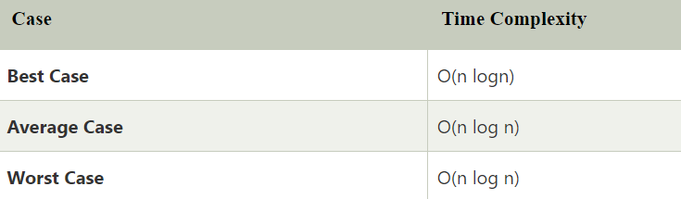
The space complexity of the Heap sort is O(1)

Slide 67
POSSIBLE APPLICATIONS
  When we want to know the task that carry the highest priority given a large number of things to do
  Interval scheduling, when we have a list of certain tasks with start and finish times and we want to do as many tasks as possible
  Implementation of priority
  Sorting a list of elements that need and efficient sorting algorithm

